Slide 1
Simple Chat Server
Gabriel Dimitrov & Julian Leuze

Slide 2
OUTLINE: Sequence Diagramm Component Diagramm Mockups Lesson learnt Demonstration

Slide 3
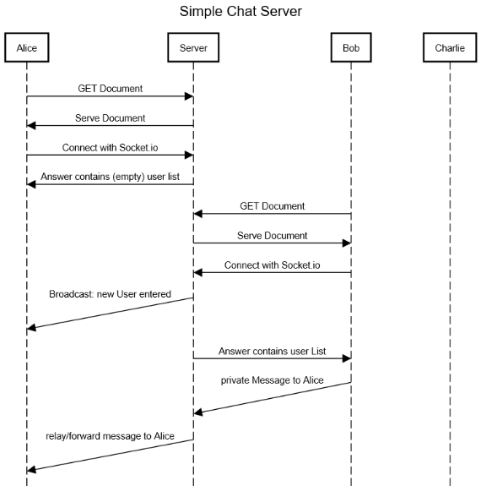

Slide 4
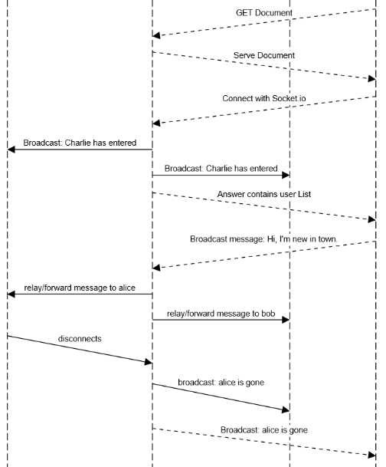

Slide 5
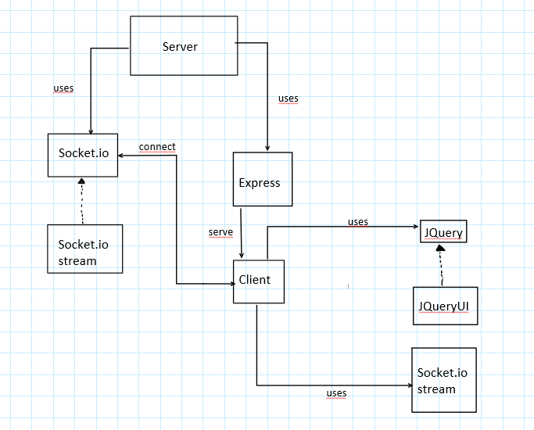
Component Diagram

Slide 6
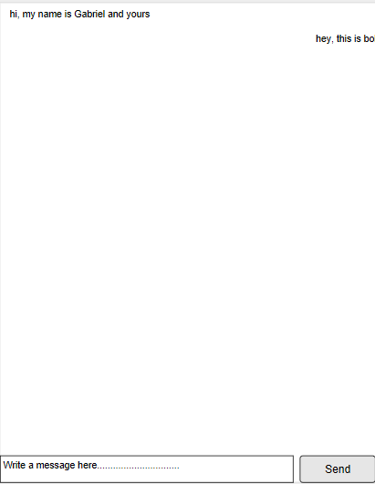
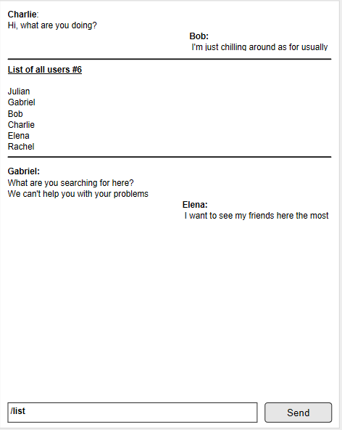
Design Mockups

Slide 7
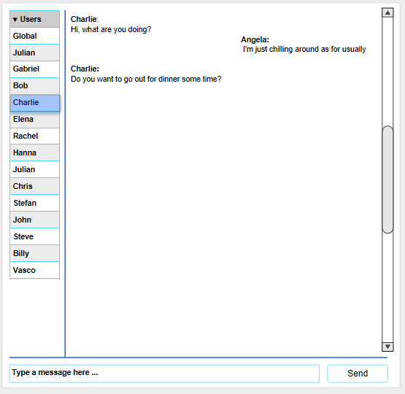
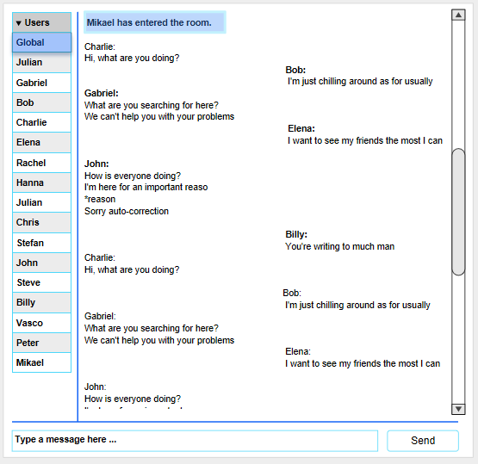

Slide 8
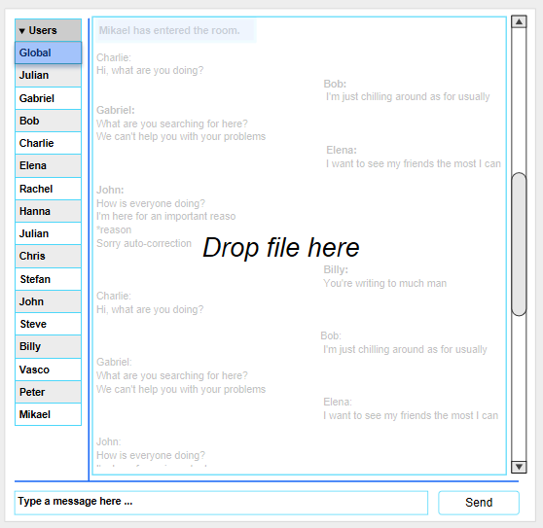
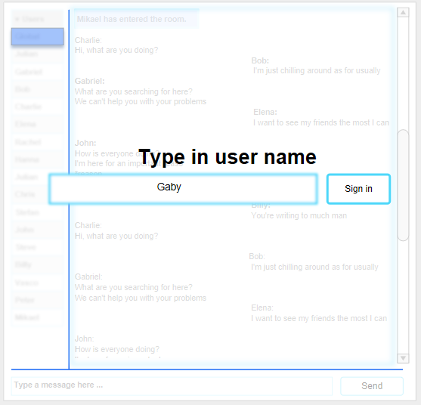

Slide 9
Lesson learnt
Making use of virtual folder using “express.static()”
Making use of event based thinking in relation to client-server interaction

Slide 10
Demonstration
Worldwide access: Hsrt.ircchat.eu:3000
Local access: Chat.local:3000

